Slide 1

Social Networking Ethical Issues Presented by: Atiq Ahammed(BSSE0817) Presented to: Rezvi Shahariar & BSSE8th batch

Slide 2



Facts Issues
Disloyal
Not everyone is going to be a good
“neighbor” and abide by the rules of the community
Cyber bulling
Cyberstalking
a form of bulling using electronic means
the use of the internet or other electronic means to harass an individual, group, or organization
Encounters with
sexual predators
Uploading of inappropriate material
a person seen as trying to obtain sexual contact with another person in a metaphorically "predatory" or abusive manner
posting mean, personal, or false information about the victim
Crosses limit
Many will stretch or exceed the
bounds of generally accepted behavior

Slide 3

Harassment
Humiliation
Cyber bullying
Threatening
Via Internet or phone call
Among 15 – 16 years olds
More common in Female
Last stage cause Suicide

Slide 4



Form of Cyber bullying
Sending inappropriate messages
Stealing the victim’s password and modifying his or her profile
Sending threatening messages
Posting mean, personal, or false information

Slide 5


i
Threatening behavior
Cyberstalking
ii
Unwanted advantage
iii
Adult version of cyberbullying

Slide 6




Policies
against uploading videos depicting violence
Deletion
website has right to material and terminate user accounts that violate the site’s policies
Limits
on content that is sexually explicit, hateful, or
violent, or that promotes illegal activity
Uploading Inappropriate Material

Slide 7
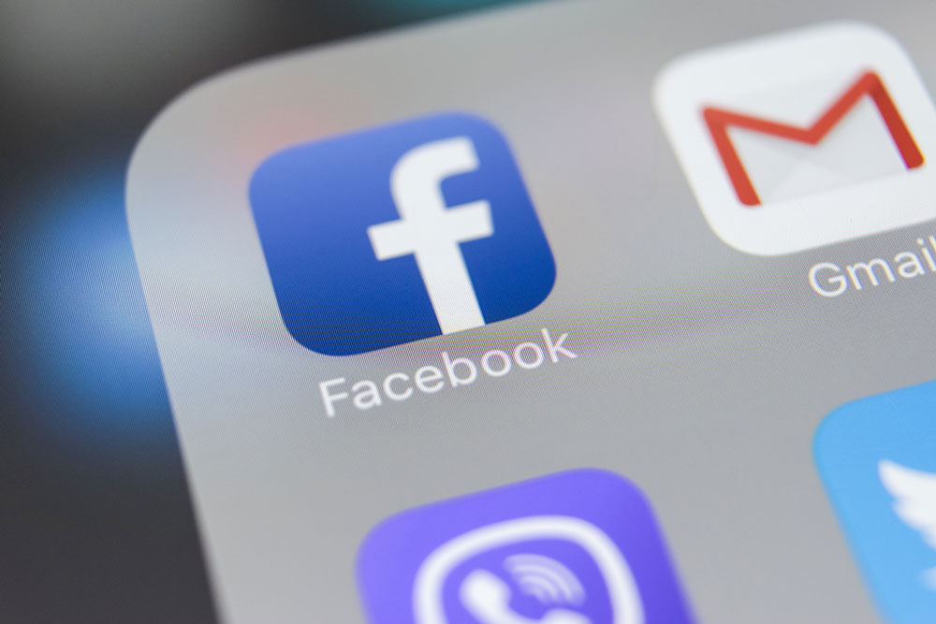




Prevention
Increasing morality
Increasing consciousness
Awareness
Hiding Confidential Information

Slide 8

Thank you for your patients

